Slide 1
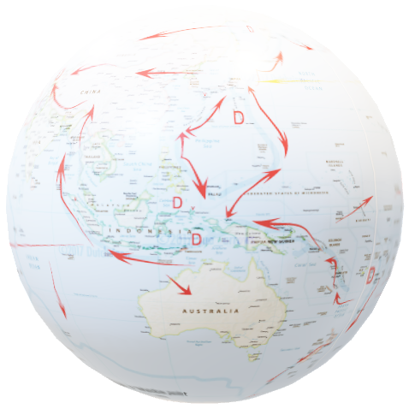
TerriaJS - An open-source framework for
web-based geospatial catalogue explorers
NATIONAL MAP
“TerriaJS was born late 2014 thanks to NationalMap. It started as a web based platform. The Australian NationalMap platform contributed greatly in opening data by government agencies and in discovering and consuming open data by general public, industry, academia and the government itself. NationalMap is managed and maintained by: Digital Transformation Agency - product ownership, Geoscience Australia - product hosting, Data61 Terria - product software development.”^{[Ref]}
This presentation is about the use of TerriaMap from CSIRO with GSKY from NCI
It is primarily for developers, but is also a user guide. See GSKY_OWS_Server.docx for details.
Will take approximately 5 minutes to watch this animation.
Use GSKY_Terria_Interaction.pptx for controlled slideshow at your pace.
DISCLAIMER
Relevant code snippets from TerriaMap (TerriaJS-specs.js) and GSKY (ows.go) are shown to describe the steps. They give pointers to understand the programs, but are NOT full descriptions. More details are given in the Word document, but it too is not a tutorial to learn these extremely complex programs.
The slide show will begin in 5 seconds !

Slide 2
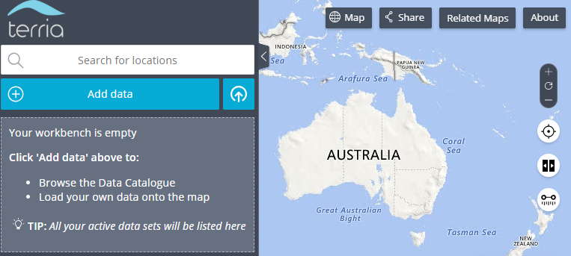
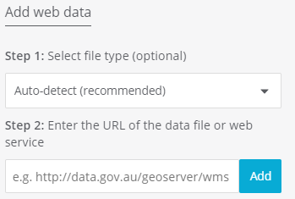
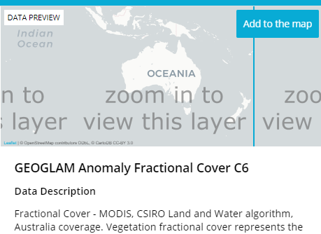
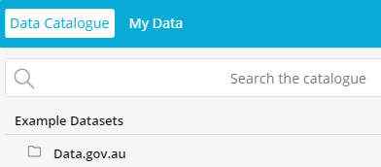
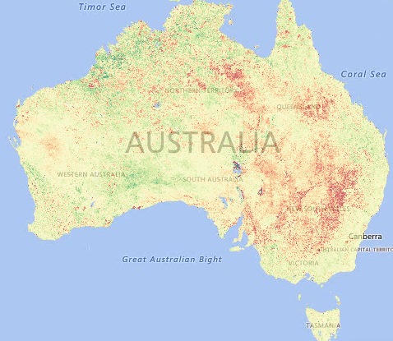
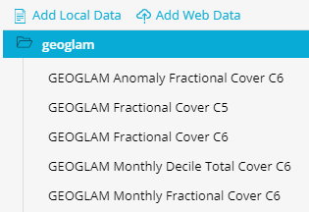
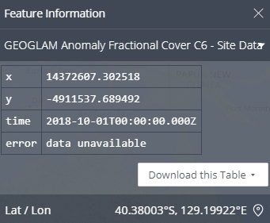
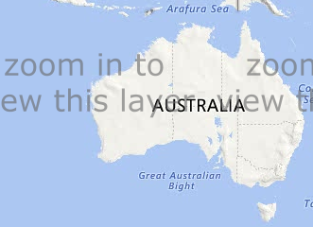
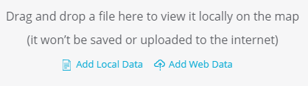


TerriaMap/GSKY User Guide
This is a step-by-step animation of the user guide. The GEOGLAM dataset is used with GSKY/Terria to demonstrate, but can be any dataset stored on GSKY servers.
Add data
My Data
http://130.56.242.15/ows/geoglam
GEOGLAM Anomaly Fractional Cover C6
Add Web Data
Next: Technical Details
1. Click: Add data
5. Click: A layer name
2. Click: My data
6. Click: Add to the map
3. Click: Add Web Data
7. Zoom: Use the mouse wheel
4. Type: Address of GSKY server. Click: Add
8. Click: On any pixel on the map
9. Click: End of slide

Slide 3
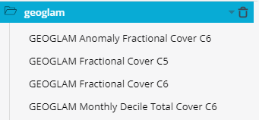
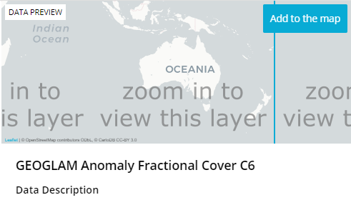
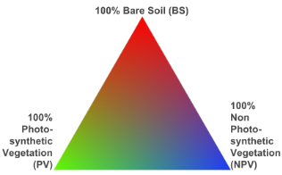


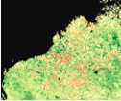
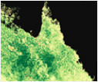
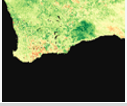
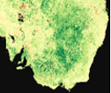
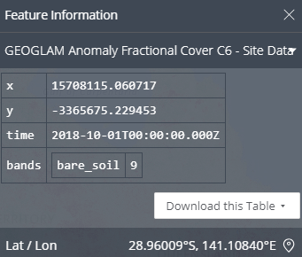
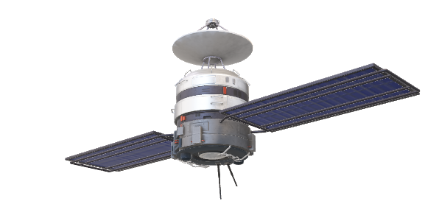
TerriaMap-GSKY Communication
This is an overview of the calls from TerriaMap to GSKY and the return communications. TerriaMap calls GSKY to get the relevant information and displays them over the map. There are five request-types, of which ‘GetMap’ is the most important.
WMS_DescribeLayer.tpl <WMS_DescribeLayerResponse version="1.1.1">
<LayerDescription name="global:c6:monthly_anom_frac_cover" owsURL="http://130.56.242.15/ows/geoglam" owsType="WMS">
<Query typeName="global:c6:monthly_anom_frac_cover"/>
</LayerDescription>
</WMS_DescribeLayerResponse>
WMS_ServiceException.tpl <ServiceExceptionReport version="1.1.1" >
<ServiceException code="LayerNotDefined" locator="MapLayerInfoKvpParser">{{ . }} no such layer on this server.</ServiceException>
</ServiceExceptionReport>
case "GetMap": &proc.GeoTileRequest{ConfigPayLoad: proc.ConfigPayLoad{… proc.NewTileIndexer(ctx, conf.ServiceConfig.MASAddress, errChan) go indexer.Run(*verbose) proc.InitTilePipeline(…) tp.Process(geoReq, *verbose): tils.EncodePNG(norm, styleLayer.Palette) w.Write(out)
XML:WMS_GetCapabilities.tpl
Service: Name, Title, Abstract, Keywords, ContactInformation
Capability: DCPType, FeatureInfo, Exception
Layers: Title, Abstract, Bbox, CRS, Times, MetadataURL, DataURL
GetCapabilities
GSKY
DescribeLayer
GetLegendGraphic
GetMap
Next: Process flow at code level
case "GetFeatureInfo":
type:FeatureCollection
Properties: x, y, time, feat_info
GetFeatureInfo

Slide 4
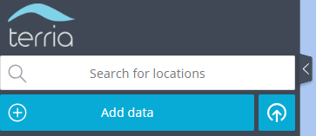
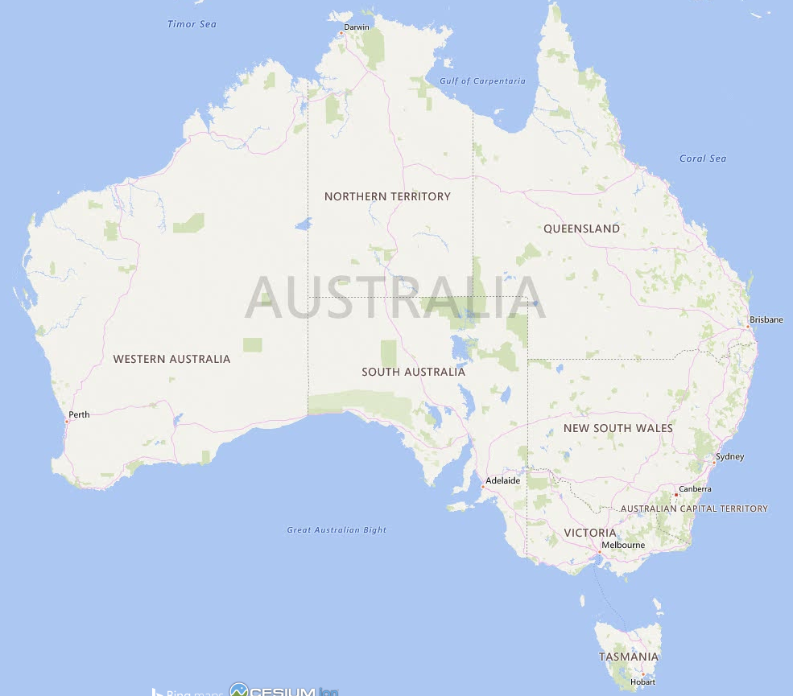


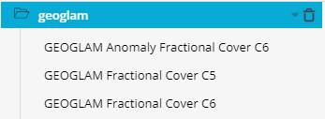

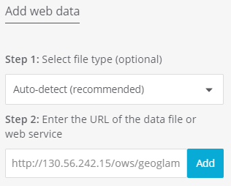

GEOGLAM – An implementation via GSKY in TerriaJS
Next Slide
Geo-spatial data stored in GSKY database can be layered over a world map. Steps and code snippets to show the usage and inner workings.
/TerriaMap/build/TerriaJS/build/TerriaJS-specs.js:44667:
return cleanUrl(this.url) + '?service=WMS&version=1.3.0&request=GetCapabilities';
http://130.56.242.15/ows/geoglam?service=WMS&request=GetCapabilities&version=1.3.0&tiled=true
gopath/src/github.com/nci/gsky/ows.go:179: case GetCapabilities:
utils.ExecuteWriteTemplateFile(w, conf, utils.DataDir+"/templates/WMS_GetCapabilities.tpl")
/TerriaMap/build/TerriaJS/build/TerriaJS-specs.js:44818:
layerTitles: {
get: function get() {
return this._allLayersInRawMetadata.map(function (layer) {
return layer.Title || layer.Name;
});
}
}

Slide 5
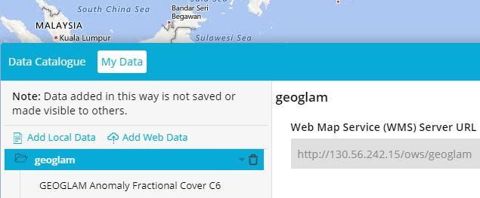
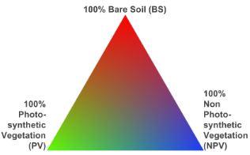
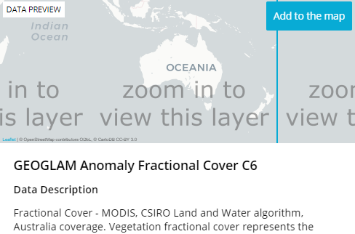
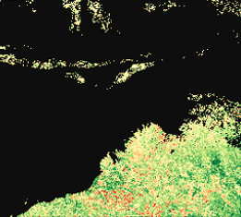
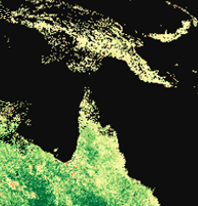
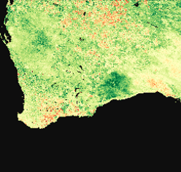
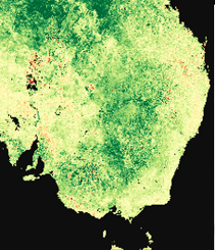

GEOGLAM – An implementation via GSKY in TerriaJS
TerriaJS is a Node.JS implementation of a webserver that can connect to various data sources that comply with WMS formats. It can send requests to GSKY and display the returned results. This slide will show an overview of the process flow. Code snippets from both TerriaJS and GSKY are shown.
/TerriaMap/build/TerriaJS/build/TerriaJS-specs.js:45977:
legendUri = new URI(cleanUrl(catalogItem.url) + '?service=WMS&version=1.1.0&request=GetLegendGraphic&format=image/png&transparent=True&layer=' + encodeURIComponent(thisLayer.Name));
http://130.56.242.15/ows/geoglam?service=WMS&version=1.1.0&request=GetLegendGraphic&format=image%2Fpng&transparent=True&layer=global%3Ac6%3Amonthly_anom_frac_cover&srs=EPSG%3A3857
/TerriaMap/build/TerriaJS/build/TerriaJS-specs.js:45449:
return new WebMapServiceImageryProvider({
url: cleanAndProxyUrl(this, this.url),
layers: this.layers,
getFeatureInfoFormats: this.getFeatureInfoFormats,
parameters: parameters,
getFeatureInfoParameters: parameters,
tilingScheme: defined(this.tilingScheme) ? this.tilingScheme : new WebMercatorTilingScheme(),
maximumLevel: maximumLevel
});
/TerriaMap/build/TerriaJS/build/TerriaJS-specs.js:45298:
var describeLayersURL = cleanUrl(that.url) + '?service=WMS&version=1.1.1&sld_version=1.1.0&request=DescribeLayer&layers=' + encodeURIComponent(that.layers);
http://130.56.242.15/ows/geoglam?time=2001-01-01T00%3A00%3A00.000Z&srs=EPSG%3A3857&transparent=true&format=image%2Fpng&exceptions=application%2Fvnd.ogc.se_xml&styles=&tiled=true&feature_count=101&service=WMS&version=1.1.1&request=GetMap&layers=global%3Ac6%3Amonthly_anom_frac_cover&bbox=15028131.257091936%2C-5009377.085697312%2C17532819.79994059%2C-2504688.542848654&width=256&height=256
http://130.56.242.15/ows/geoglam?time=2001-01-01T00%3A00%3A00.000Z&srs=EPSG%3A3857&transparent=true&format=image%2Fpng&exceptions=application%2Fvnd.ogc.se_xml&styles=&tiled=true&feature_count=101&service=WMS&version=1.1.1&request=GetMap&layers=global%3Ac6%3Amonthly_anom_frac_cover&bbox=15028131.257091936%2C-2504688.542848654%2C17532819.79994059%2C0&width=256&height=256
http://130.56.242.15/ows/geoglam?time=2001-01-01T00%3A00%3A00.000Z&srs=EPSG%3A3857&transparent=true&format=image%2Fpng&exceptions=application%2Fvnd.ogc.se_xml&styles=&tiled=true&feature_count=101&service=WMS&version=1.1.1&request=GetMap&layers=global%3Ac6%3Amonthly_anom_frac_cover&bbox=12523442.714243278%2C-2504688.542848654%2C15028131.257091936%2C0&width=256&height=256
http://130.56.242.15/ows/geoglam?service=WMS&version=1.1.1&sld_version=1.1.0&request=DescribeLayer&layers=global%3Ac6%3Amonthly_anom_frac_cover
http://130.56.242.15/ows/geoglam?time=2001-01-01T00%3A00%3A00.000Z&srs=EPSG%3A3857&transparent=true&format=image%2Fpng&exceptions=application%2Fvnd.ogc.se_xml&styles=&tiled=true&feature_count=101&service=WMS&version=1.1.1&request=GetMap&layers=global%3Ac6%3Amonthly_anom_frac_cover&bbox=15028131.257091936%2C-5009377.085697312%2C17532819.79994059%2C-2504688.542848654&width=256&height=256
gopath/src/github.com/nci/gsky/ows.go:206:
case DescribeLayer:
utils.ExecuteWriteTemplateFile(w, conf.Layers[idx], utils.DataDir+"/templates/WMS_DescribeLayer.tpl")
gopath/src/github.com/nci/gsky/ows.go:220::
case GetMap:
proc.InitTilePipeline(ctx, conf.ServiceConfig.MASAddress, conf.ServiceConfig.WorkerNodes, conf.Layers[idx].MaxGrpcRecvMsgSize, conf.Layers[idx].WmsPolygonShardConcLimit, conf.ServiceConfig.MaxGrpcBufferSize, errChan)
out, err := utils.EncodePNG(norm, styleLayer.Palette)
w.Write(out)

